Slide 1

Video Game Sales Data Analysis
An In-Depth Analysis of Sales Across Regions and Genres
Presented by:
Elsayed Ibrahim

Slide 2
Introduction
Content:
)
Brief Introduction to the Project:
The video game industry has seen tremendous growth and transformation since its inception. This project aims to analyze the sales data of video games from various regions over several decades. By examining trends, patterns, and correlations, we aim to gain insights into the factors driving the industry's evolution and success.
Objectives of the Analysis:
Identify the top-selling video game titles worldwide.
Determine the year with the highest sales and track the industry's growth over time.
Explore the specialization of consoles in particular genres.
Analyze regional popularity and performance of video game titles.
Correlate the development of video game controllers and GPUs with genre and sales trends.

Slide 3
Data Overview
Content:
Total number of titles analyzed: 64,016
Key attributes: title, console, genre, publisher, developer, critic score, total sales, regional sales, release date
Regions covered: North America, Japan, EU, Africa, and the rest of the world

Slide 4
Analysis Focus Areas
Content:
Which titles sold the most worldwide?
Which year had the highest sales? Has the industry grown over time?
Do any consoles specialize in particular genres?
What titles are popular in one region but flop in another

Slide 5
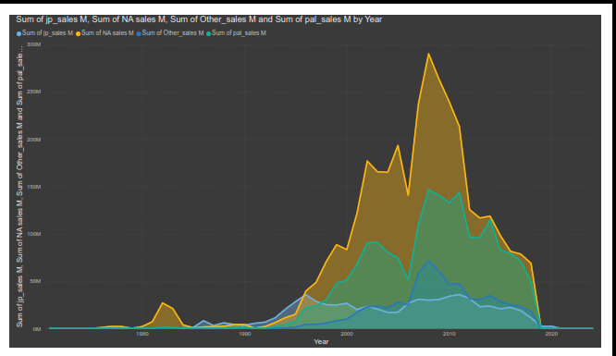
Genre Sales by Region
Notes:
Overall Analysis:
North America has the highest sales across most genres, indicating a large market for video games.
Europe and Africa (PAL region) also show strong sales, particularly in genres like Action, Sports, and Racing.
Japan has significant sales in genres like Action, Role-Playing, and Sports, but generally lower sales compared to NA and PAL regions.
Other regions have the lowest sales across all genres, suggesting a smaller market presence.
Key Insights:
Action and Sports games dominate sales across all regions, particularly in North America and PAL regions.
Role-Playing games have a significant presence in Japan and North America.
Racing games show strong popularity in the PAL and NA regions.
Adventure and Platform games have a steady presence across all regions but don't reach the sales levels of Action or Sports games.
MMO and Miscellaneous games have the lowest sales, indicating niche markets or less popularity.

Slide 6
Total Sales by Region
North America: Highest sales across most genres, indicating a large market for video games.
01
Europe and Africa (PAL region): Strong sales, particularly in genres like Action, Sports, and Racing.
02
Japan: Significant sales in genres like Action, Role-Playing, and Sports, but generally lower sales compared to NA and PAL regions.
03
Other Regions: Lowest sales across all genres, suggesting a smaller market presence.
04
Notes:
Overall Analysis:
North America has the highest sales across most genres, indicating a large market for video games.
Europe and Africa (PAL region) also show strong sales, particularly in genres like Action, Sports, and Racing.
Japan has significant sales in genres like Action, Role-Playing, and Sports, but generally lower sales compared to NA and PAL regions.
Other regions have the lowest sales across all genres, suggesting a smaller market presence.
Key Insights:
Action and Sports games dominate sales across all regions, particularly in North America and PAL regions.
Role-Playing games have a significant presence in Japan and North America.
Racing games show strong popularity in the PAL and NA regions.
Adventure and Platform games have a steady presence across all regions but don't reach the sales levels of Action or Sports games.
MMO and Miscellaneous games have the lowest sales, indicating niche markets or less popularity.

Slide 7
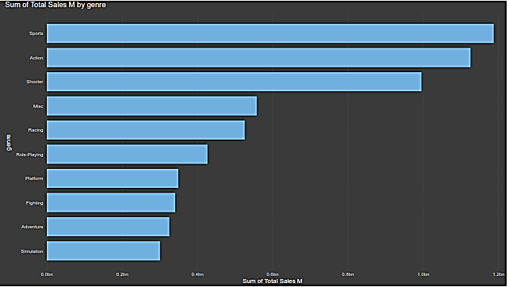
Sales by Genre
Key Insights:
Dominance of Action Games: 37.28%
Popularity of Sports Games: 17.98%
Diverse Market: Racing (7.96%), Role-Playing (6.46%), Platform (5.29%)
Niche Markets: Music (0.78%), Miscellaneous (0.23%), MMO (0.14%)
Notes:
Commentary:
Market Trends: Action and sports games dominate.
Potential for Growth: Role-Playing and Adventure genres.
Niche Opportunities: Dedicated fan bases in smaller genres.
Strategic Focus: Target high-potential genres, explore niche markets.

Slide 8
Sales by Genre
Dominance of Action Games: Action games lead the market with 37.28% of total sales, indicating a strong preference for high-energy and engaging gameplay.
1
Popularity of Sports Games: Sports games account for 17.98% of total sales, showing a significant market share and widespread appeal across different regions.
2
Diverse Market: Other genres such as Racing (7.96%), Role-Playing (6.46%), and Platform (5.29%) also hold notable market shares, highlighting the diversity in player preferences.
3
Niche Markets: Genres like Music (0.78%), Miscellaneous (0.23%), and MMO (0.14%) have smaller market shares, indicating niche but potentially loyal audiences.
4
Notes:
Commentary:
Market Trends: Action and sports games dominate.
Potential for Growth: Role-Playing and Adventure genres.
Niche Opportunities: Dedicated fan bases in smaller genres.
Strategic Focus: Target high-potential genres, explore niche markets.

Slide 9


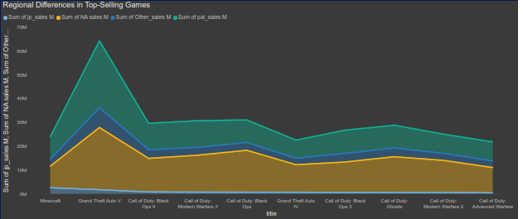
Regional Differences in Top-Selling Games
Notes:
Commentary:
North America Dominance: NA sales are highest across all top titles, with Call of Duty: Black Ops and Grand Theft Auto V leading.
PAL Region Strength: The PAL region shows strong sales, particularly for Grand Theft Auto V and Call of Duty titles, reflecting a robust market.
Emerging Markets: Other regions have lower sales, suggesting opportunities for market expansion.
Japanese Market: Sales are lower in Japan, with Minecraft performing better than other titles, indicating a preference for certain types of games.

Slide 10



Regional Differences in Top-Selling Games
Key Points:
North America (NA): Dominates sales for all top titles, indicating a strong market presence.
PAL (Europe and Africa): Significant sales, particularly for Grand Theft Auto V and Call of Duty series.
Other Regions: Generally lower sales compared to NA and PAL, with Minecraft showing relatively higher sales.
Japan (JP): Lower sales overall, but notable for titles like Minecraft and Grand Theft Auto V.
Notes:
Commentary:
North America Dominance: NA sales are highest across all top titles, with Call of Duty: Black Ops and Grand Theft Auto V leading.
PAL Region Strength: The PAL region shows strong sales, particularly for Grand Theft Auto V and Call of Duty titles, reflecting a robust market.
Emerging Markets: Other regions have lower sales, suggesting opportunities for market expansion.
Japanese Market: Sales are lower in Japan, with Minecraft performing better than other titles, indicating a preference for certain types of games.

Slide 11
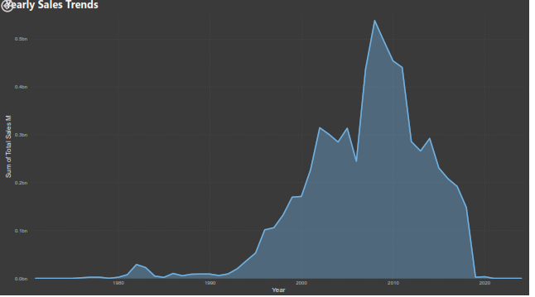
Yearly Sales Trends
Key Points:
Early Years (1971-1980): Sales were minimal, with a notable spike in 1981.
1980s Growth (1981-1989): Significant growth in 1982 and 1983, followed by fluctuating sales.
1990s Boom (1990-1999): Steady increase, with substantial growth starting in 1994 and peaking in 1999.
2000s Peak (2000-2009): Rapid growth, reaching the highest sales in 2008, followed by a slight decline.
2010s Decline (2010-2019): Gradual decline in sales after 2011, with a notable drop in 2018.
Notes:
Commentary:
Early Industry (1971-1980): The video game industry was in its infancy, with limited sales and market penetration.
Emerging Market (1980s): Introduction of popular consoles and games led to significant growth, particularly in the early 1980s.
Market Expansion (1990s): The 1990s saw a boom in sales, driven by advancements in technology and the popularity of new game titles.
Golden Era (2000s): The 2000s marked the peak of video game sales, with record-breaking years and widespread market adoption.
Market Saturation (2010s): The early 2010s saw high sales, but a gradual decline set in, possibly due to market saturation and changes in consumer preferences.

Slide 12
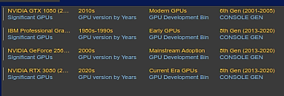
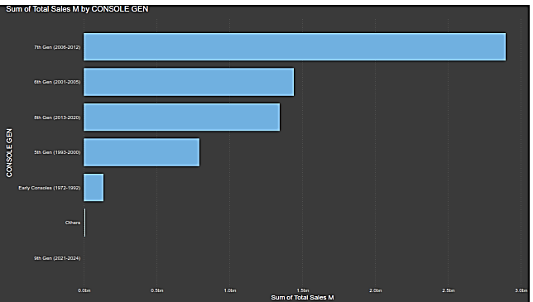
Console Generation and GPU Developments
Evolution of NVIDIA Graphics Cards 2000-2020 (youtube.com)
Notes:
Explanation of Bins
Early GPUs (1980s-1990s):
This era marks the introduction of graphics processing units designed to handle both 2D and 3D graphics acceleration, paving the way for modern gaming and graphical applications.
Mainstream Adoption (2000s):
The 2000s saw significant advancements in GPU technology with real-time shading, programmable shaders, and marked improvements in performance, making high-quality graphics more accessible.
Modern GPUs (2010s):
The 2010s brought about revolutionary changes such as real-time ray tracing and AI-enhanced graphics, leading to a significant leap in graphical fidelity and performance.
Current Era GPUs (2020s):
The most recent advancements include enhanced ray tracing, Deep Learniang Super Sampling (DLSS), and further integration of AI technologies, pushing the boundaries of what's possible in gaming and graphical applications.

Slide 13
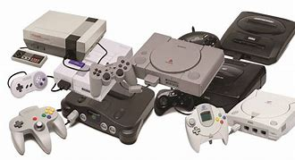

Console Generation and GPU Developments
Early GPUs (1980s-1990s):
Introduction of GPUs handling 2D and 3D graphics acceleration.
Console Generation: Laid the foundation for early gaming consoles with basic graphical capabilities.
Mainstream Adoption (2000s):
Significant advancements with real-time shading, programmable shaders, and improved performance.
Console Generation: Supported 6th Gen consoles (2001-2005), enhancing graphical quality and gaming experience.
Modern GPUs (2010s):
Revolutionary changes with real-time ray tracing and AI-enhanced graphics.
Console Generation: Enabled 8th Gen consoles (2013-2020) to deliver high graphical fidelity and immersive gaming experiences.
https://www.youtube.com/watch?v=oWmdxeAFS-I
Notes:
Explanation of Bins
Early GPUs (1980s-1990s):
This era marks the introduction of graphics processing units designed to handle both 2D and 3D graphics acceleration, paving the way for modern gaming and graphical applications.
Mainstream Adoption (2000s):
The 2000s saw significant advancements in GPU technology with real-time shading, programmable shaders, and marked improvements in performance, making high-quality graphics more accessible.
Modern GPUs (2010s):
The 2010s brought about revolutionary changes such as real-time ray tracing and AI-enhanced graphics, leading to a significant leap in graphical fidelity and performance.
Current Era GPUs (2020s):
The most recent advancements include enhanced ray tracing, Deep Learniang Super Sampling (DLSS), and further integration of AI technologies, pushing the boundaries of what's possible in gaming and graphical applications.

Slide 14
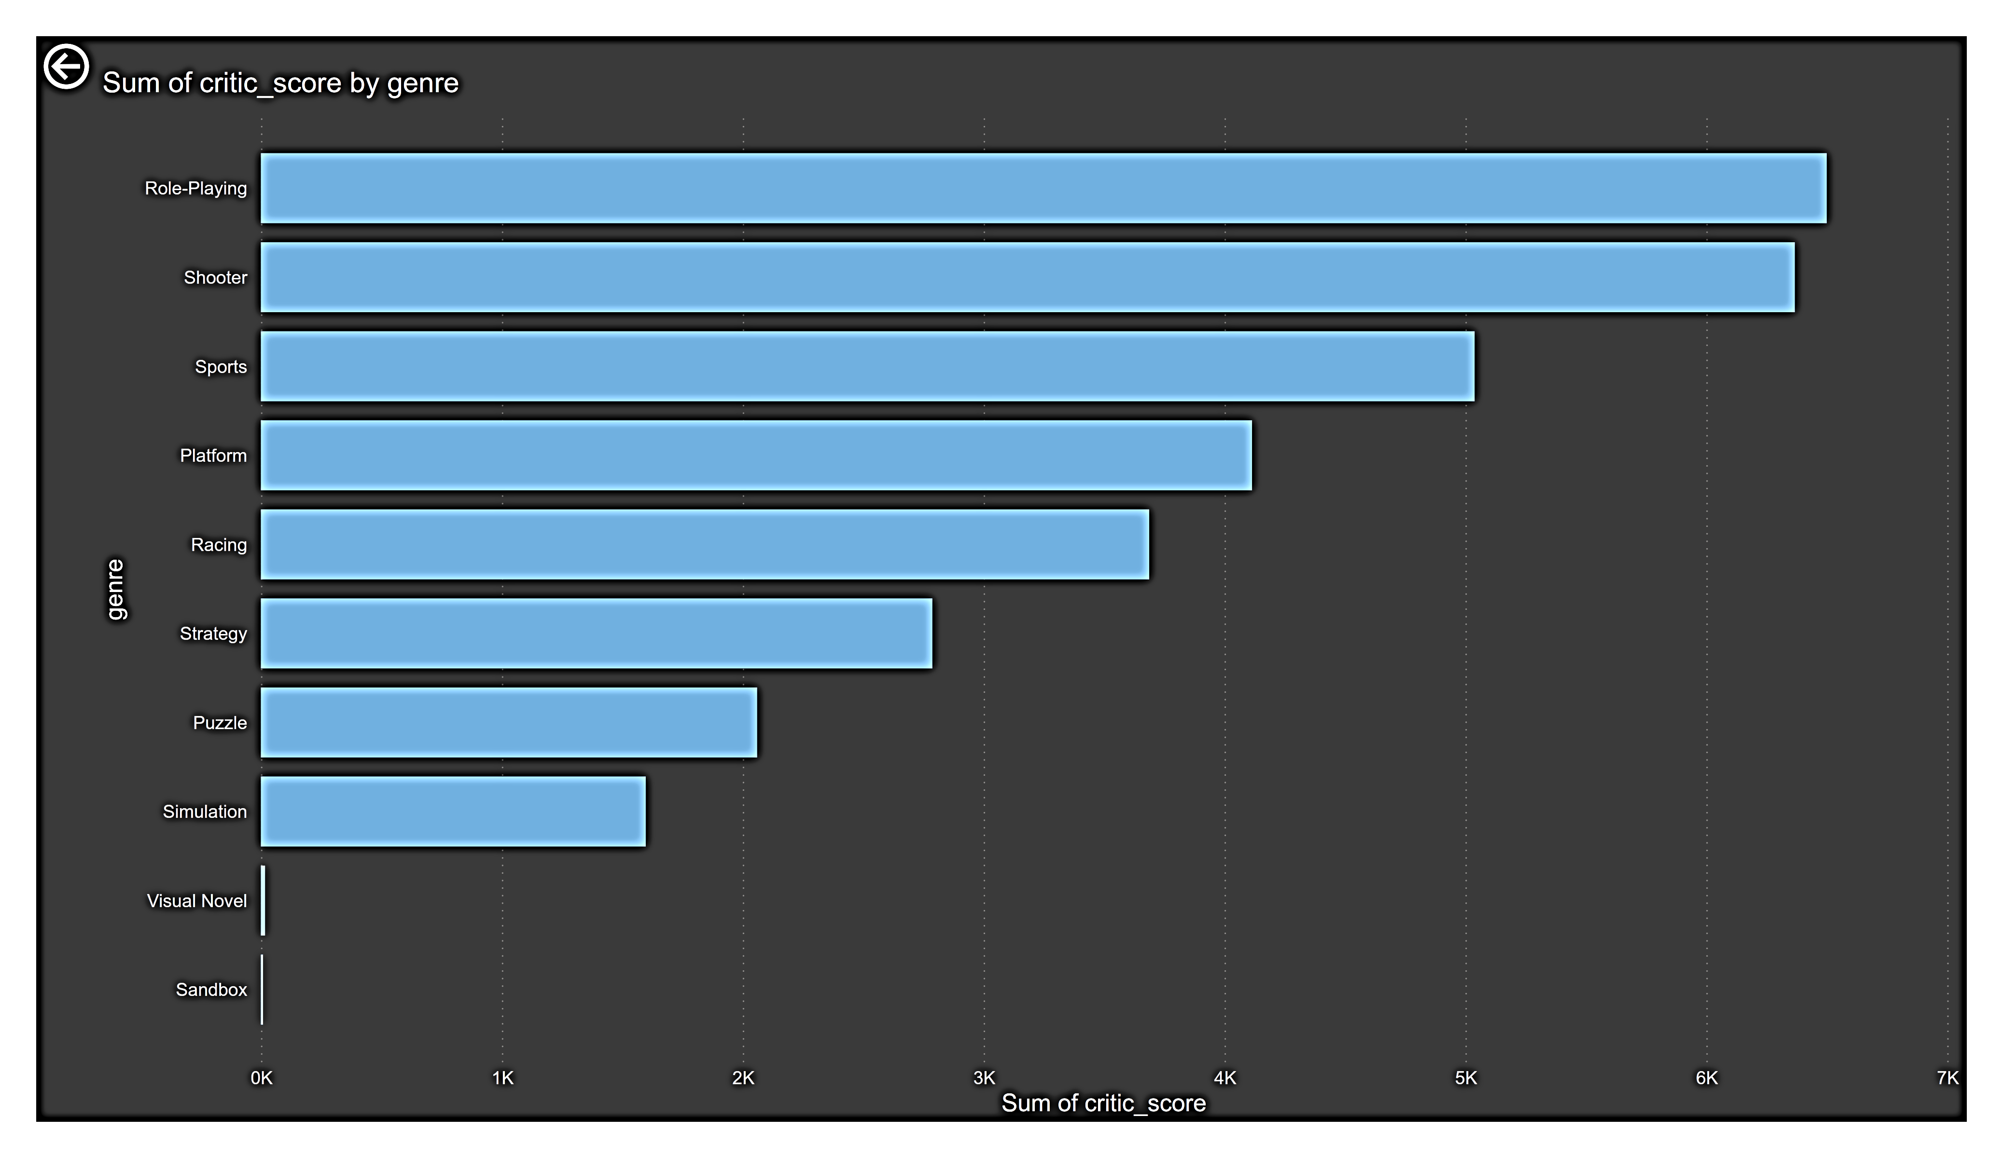
Critic Score Insights by Video Game Genre
Key Insights:
Role-Playing games have the highest sum of critic scores, indicating high critical acclaim.
Shooter and Sports games follow closely, suggesting strong critical reception.
Sandbox and Visual Novel games have the lowest sum of critic scores, indicating lower critical acclaim.

Slide 15
Final Recommendations
Focus on North America and PAL regions.
1
Prioritize Action and Sports game genres.
2
Target Role-Playing and Racing genres.
3
Leverage modern and current GPU technologies.
4
Expand into emerging video game markets.
5
Develop strategies for increasing market presence.
6

Slide 16
Questions & Answers

Slide 17
Thanks
LinkedIn : https://www.linkedin.com/in/elsayed-mishaqa-8102ab2a4/

